Slide 1
Project on: Docker & Selenium
Sowmya kadari

Slide 2
CONTENTS
Introduction
Project 1 (Docker):
Creating and Importing
Source Code.
Build & Run
Output.
Project 2(Selenium)
Source Code.
Output

Slide 3
Introduction
Project 1: Docker.
Making a spring boot project and uploading its image on Docker.
Project 2: Selenium.
Automating a website using Selenium.

Slide 4
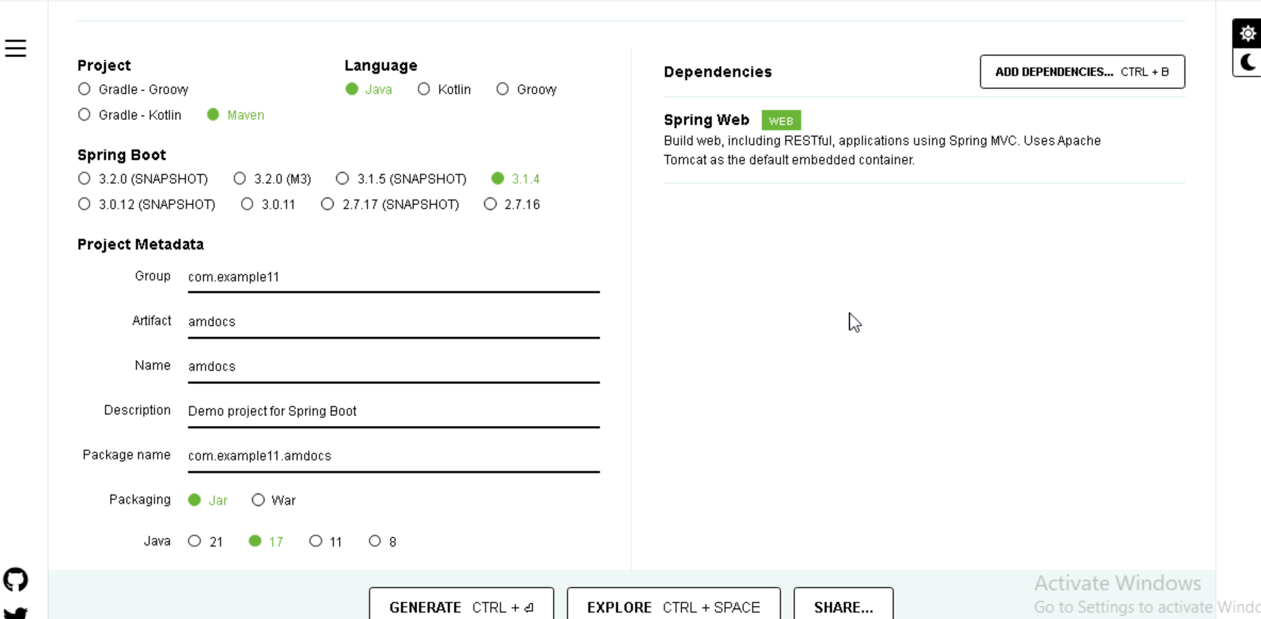
Project 1(Creating & Importing)

Slide 5
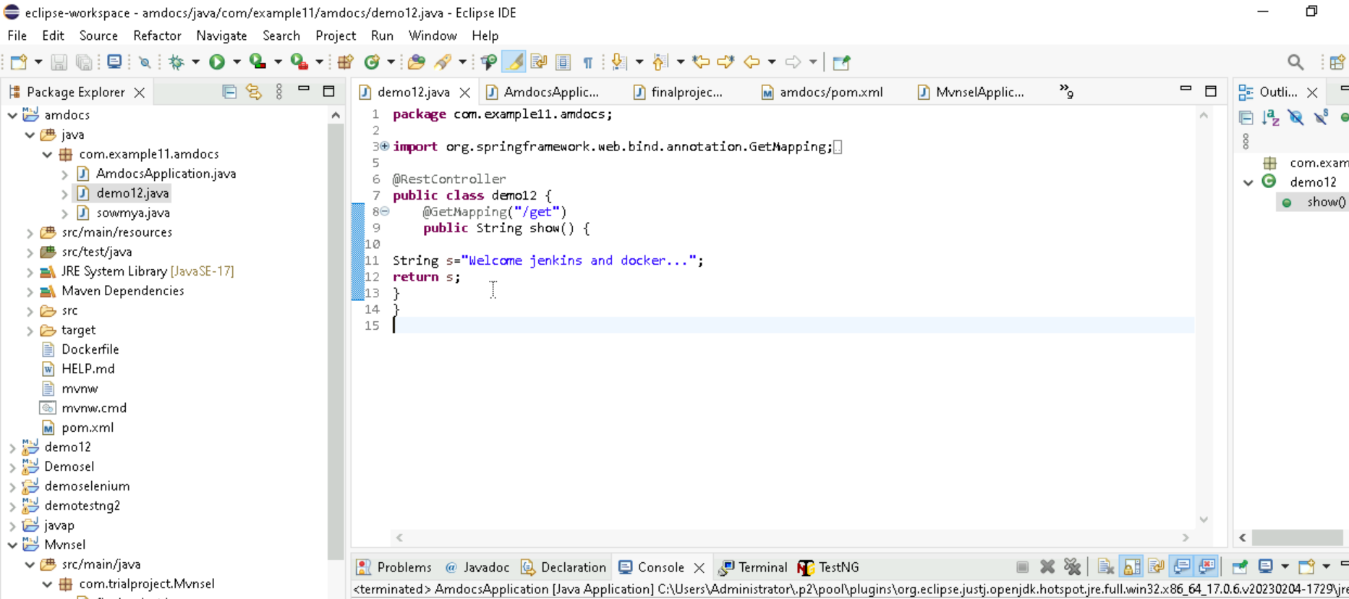
(Source Code)

Slide 6
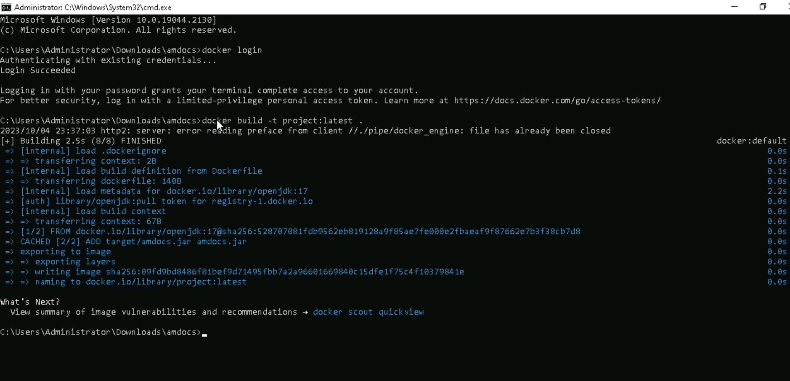
BUILD IMAGE

Slide 7
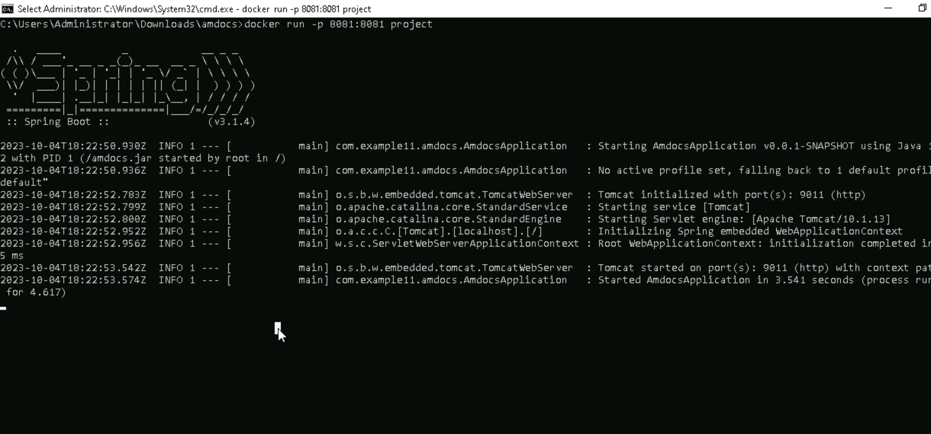
RUN IMAGE

Slide 8
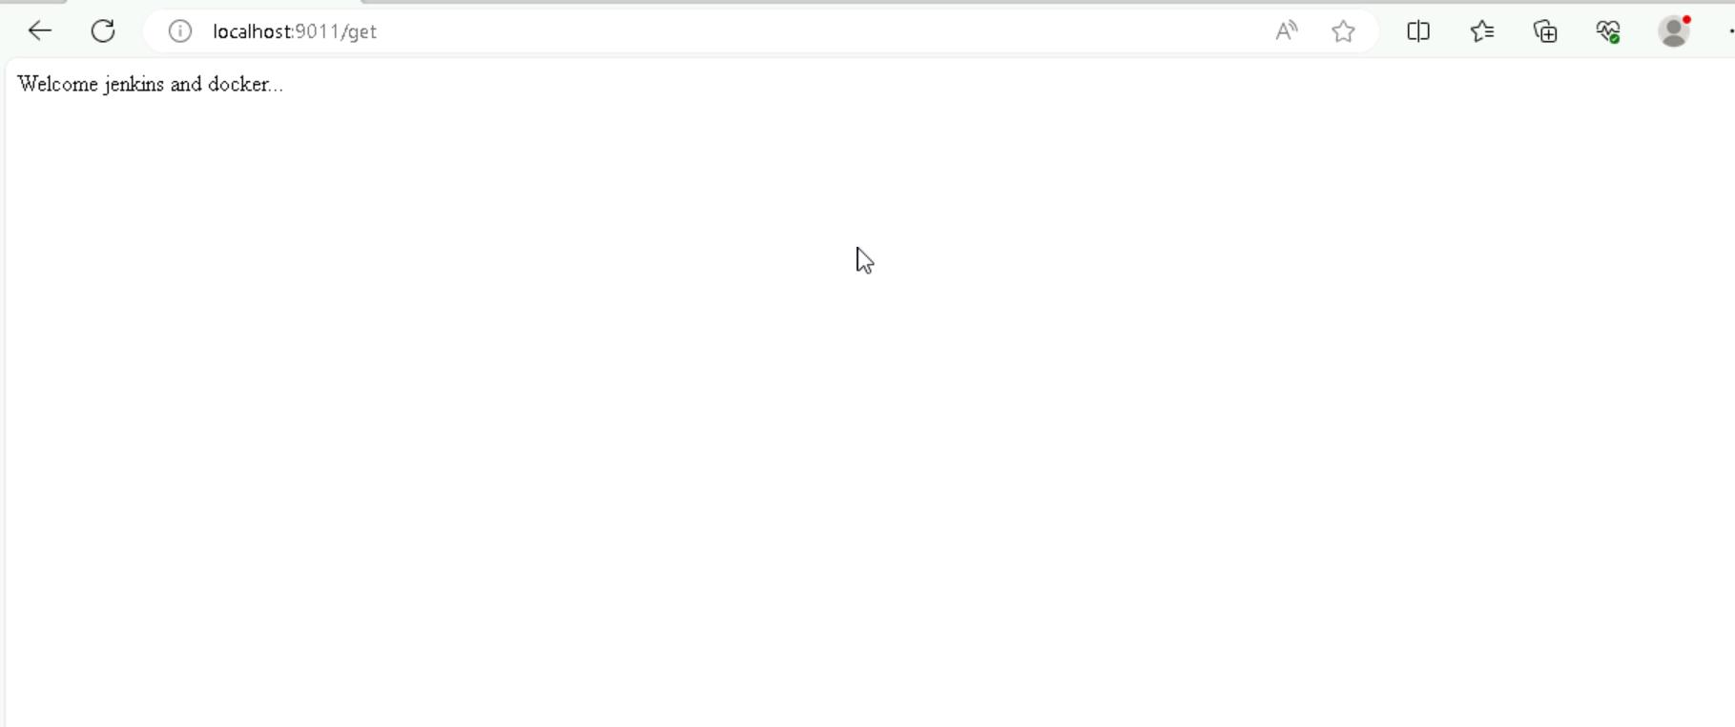
OUTPUT

Slide 9
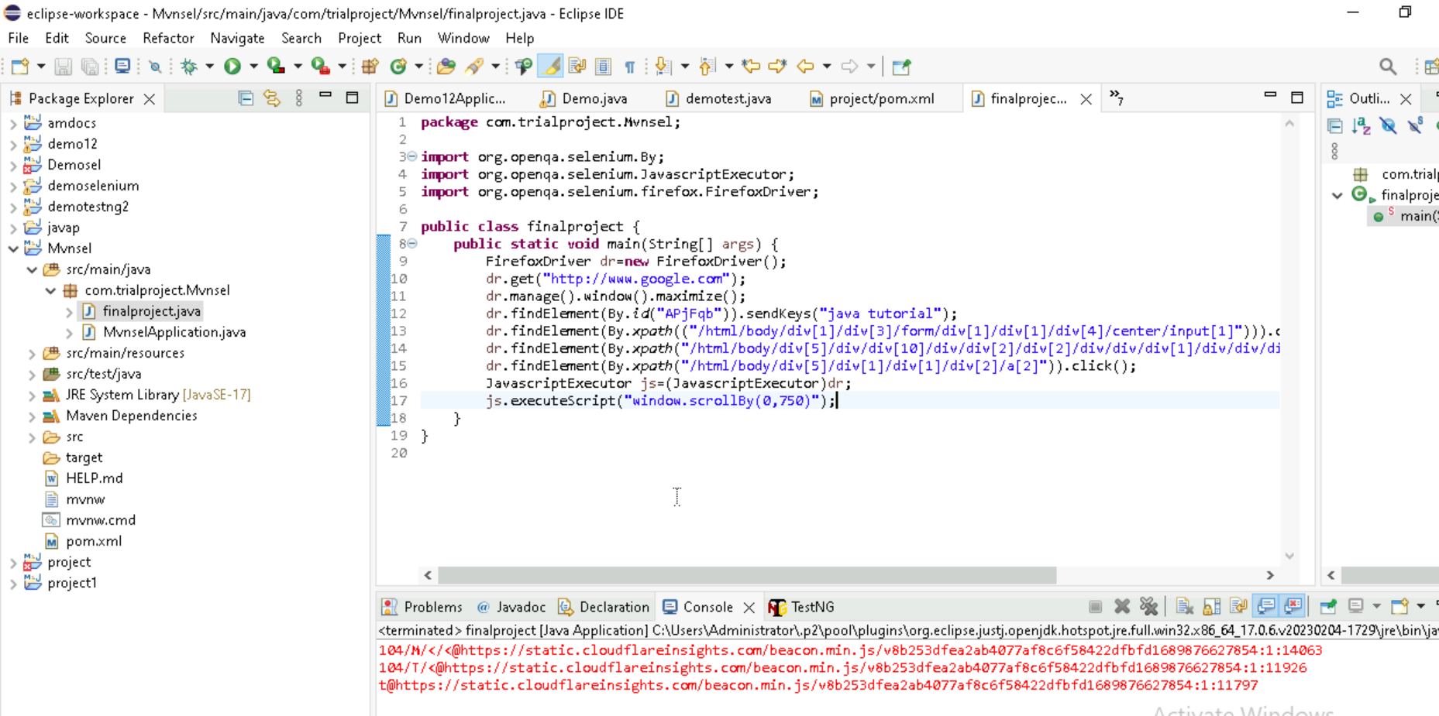
Project 2(Source Code)

Slide 10
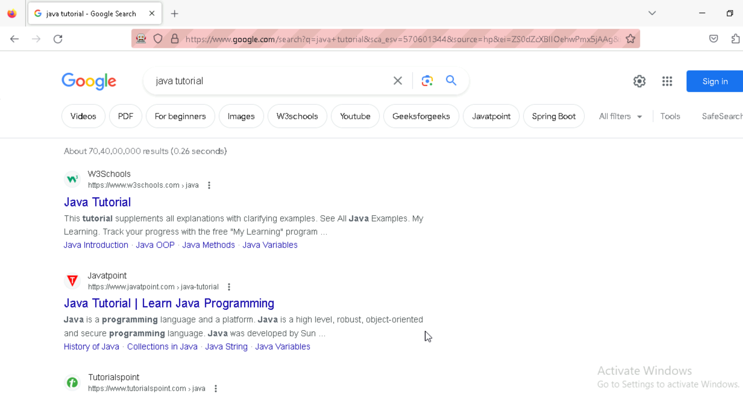
(OUTPUT)

Slide 11
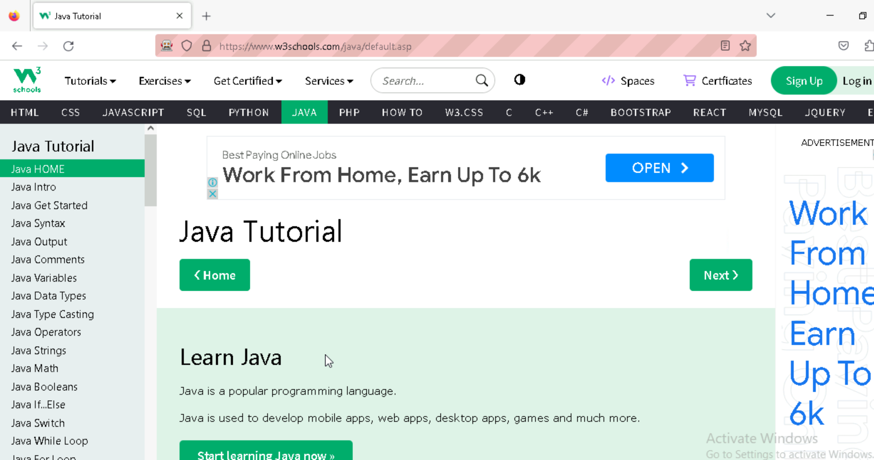

Slide 12
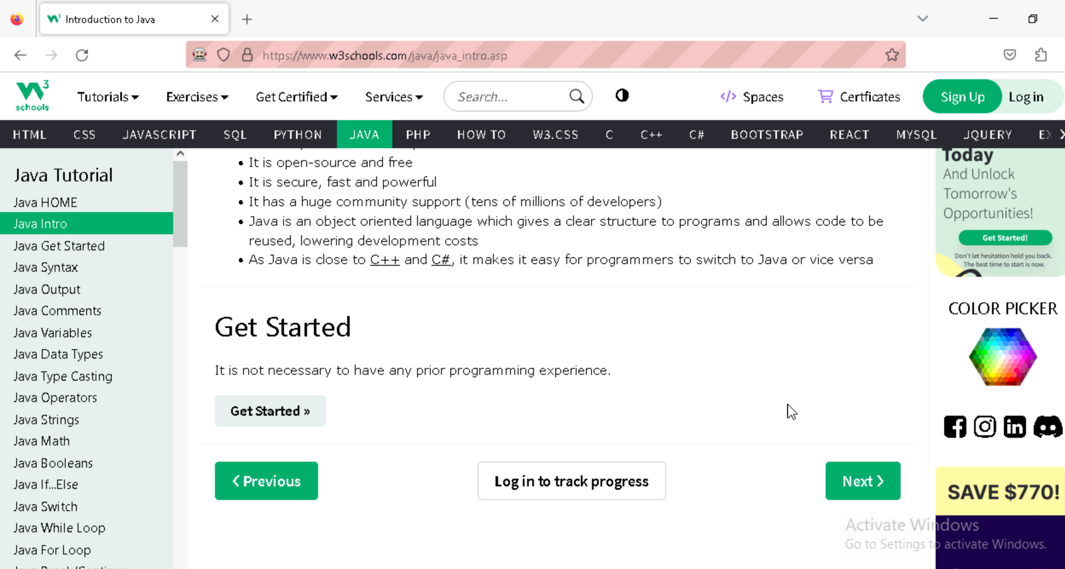

Slide 13
THANK YOU

